Slide 1
Smart water Fountains

Slide 2
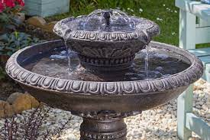
SMART WATER FOUNTAIN
Smart water fountains are innovative devices combine water filtration with advanced technology. They offer touchless, hands-free operation and often feature sensors for user interaction and maintenance alerts. Connectivity options enable remote monitoring, data analytics, and customization. These fountains are ideal for environments like offices and public spaces, promoting water quality, hygiene, and sustainability. They also encourage the use of reusable containers, reducing the need for single-use plastic bottles.

Slide 3
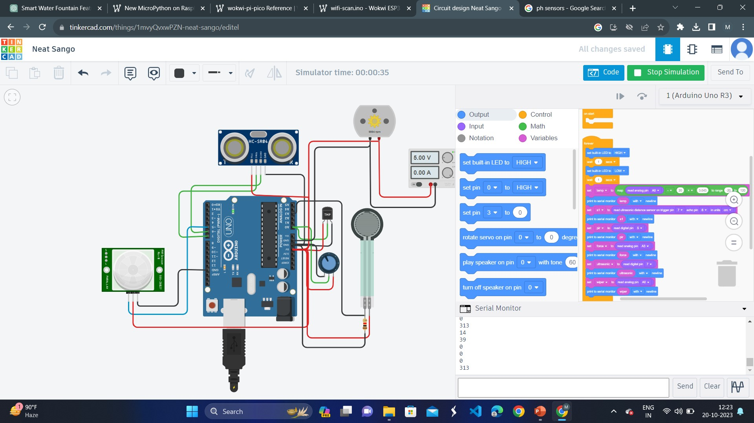
TINKERCAD

Slide 4
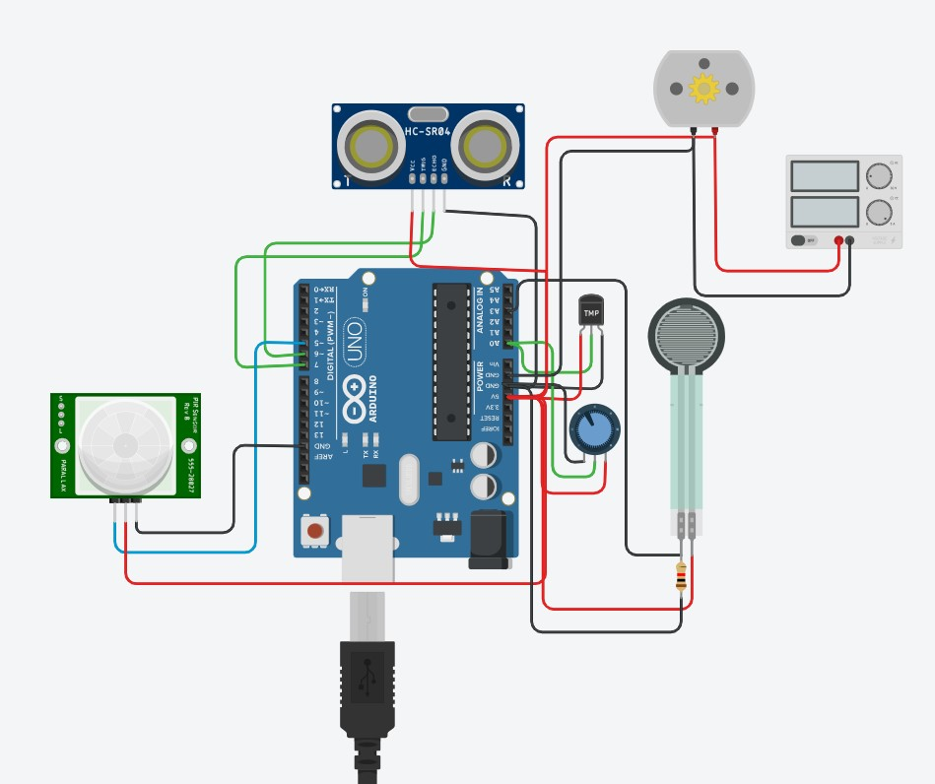



Slide 5
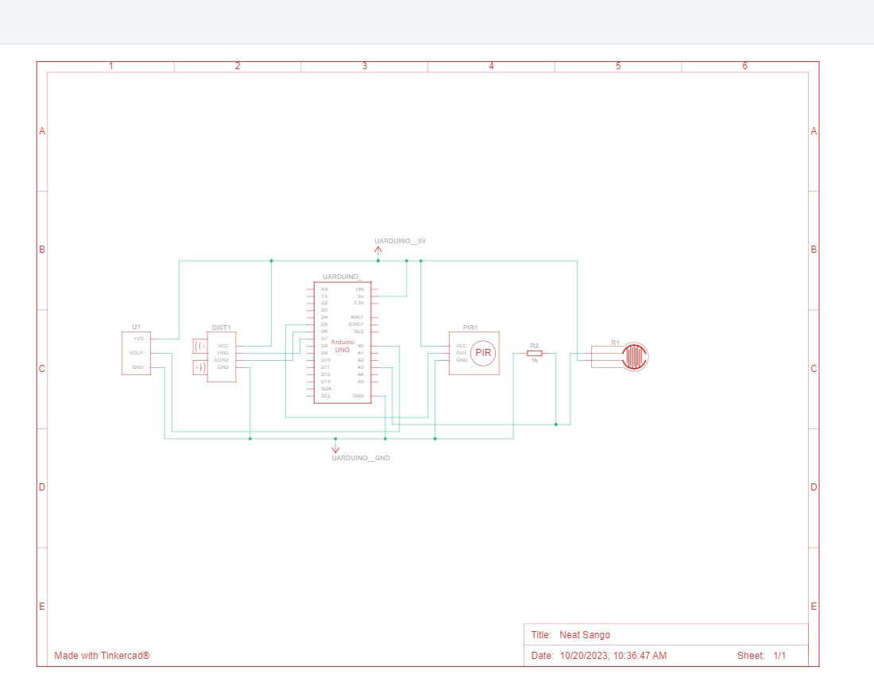
Schematic diagram of smart water fountains

Slide 6
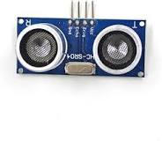
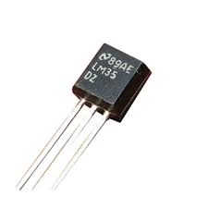
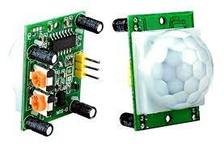
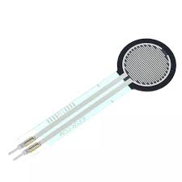
ULTRASONIC SENSOR
An ultrasonic sensor is an instrument that measures the distance to an object using ultrasonic sound waves. An ultrasonic sensor uses a transducer to send and receive ultrasonic pulses that relay back information about an object's proximity
TEMPERATURE SENSOR
A temperature sensor is a device used to measure temperature. This can be air temperature, liquid temperature or the temperature of solid matter. There are different types of temperature sensors available and they each use different technologies and principles to take the temperature measurement.
PIR SENSOR
A passive infrared sensor (PIR sensor) is an electronic sensor that measures infrared (IR) light radiating from objects in its field of view. They are most often used in PIR-based motion detectors. PIR sensors are commonly used in security alarms and automatic lighting applications.
FORCE SENSOR
A force sensor is a device that measures applied force or load. It can be in the form of strain gauges, piezoelectric elements, or other technologies. Force sensors find applications in fields such as robotics, industrial automation, and material testing.

Slide 7
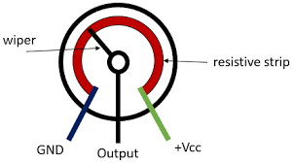
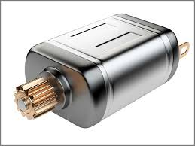
POTENTIOMETER
These include an additional set of terminals for measuring water quality, ensuring highly accurate values. Four-terminal potentiometers are often employed in calibration and measurement equipment .
DC MOTOR
A DC motor, short for Direct Current motor, is an electrical device that converts electrical energy into mechanical motion. It operates on the principle of the Lorentz force, where a current-carrying conductor in a magnetic field experiences a force. DC motors are widely used in various applications due to their simplicity and controllability.

Slide 8
THANK YOU

